Slide 1
Good Documentation and Data Integrity Practices
Covex, LLC

Slide 2

What we’ll cover:
What are Good Documentation Practices?
What is “Data Integrity” in validation documentation?
Why are they important?
Examples/Strategies for Success

Slide 3
What are Good Documentation Practices?
Good Documentation Practices (GDP’s) are the set of activities that enable you to record your raw data and hand-written entries in a legible, traceable and reproducible manner
FDA’s GLP (21 CFR Part 58), GMP (21 CFR Part 211), and GCP Regulations (21 CFR Part 312, 314 etc..) REQUIRE the use of Good Documentation Practices
Every individual is responsible for accurately recording data on GxP records

Slide 4
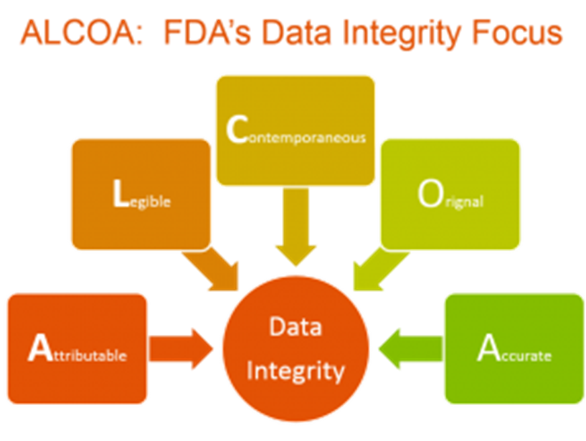
What is “Data Integrity” in validation documentation?
How much we can “trust” what we read about the validation exercise?
Can we recreate what we did?
Are the conclusions supported by what’s in the documents?
Good documentation practices are really data integrity items!

Slide 5
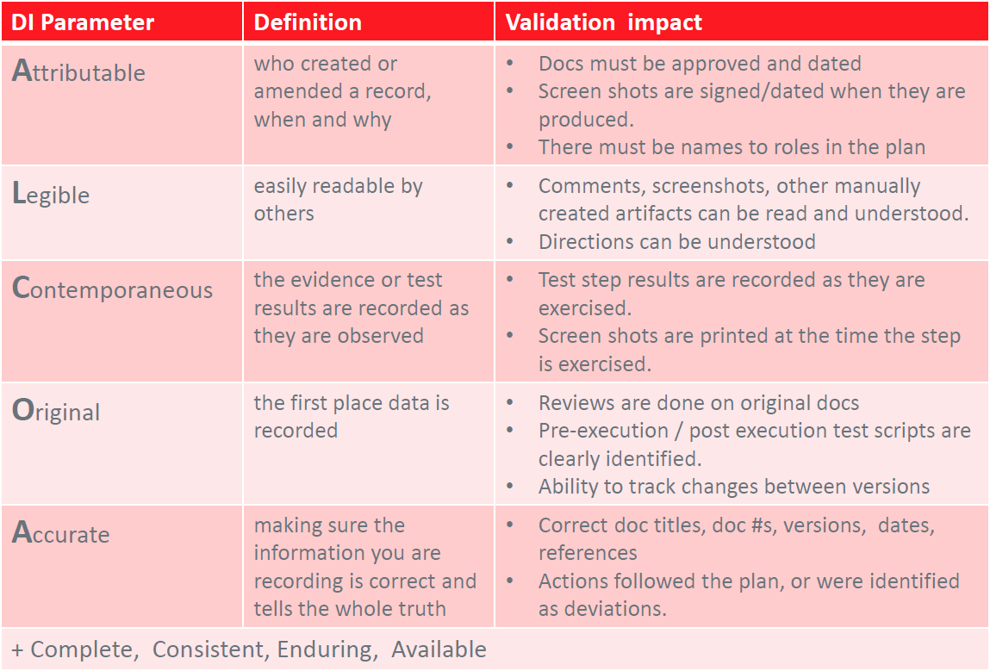
Data Integrity for Validation Documentation – ALCOA+

Slide 6
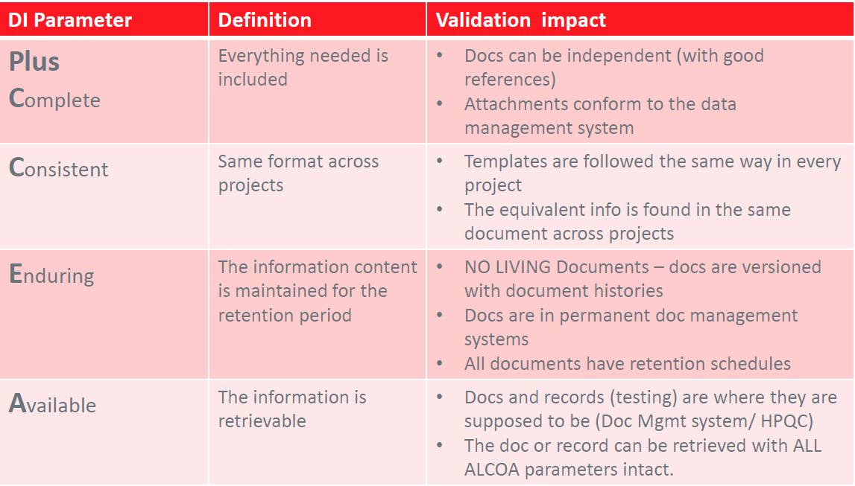
Data Integrity for Validation Documentation – ALCOA+

Slide 7
Data Integrity for Validation Documentation
FDA regulations - Where is ALCOA written?
For attributable, see §§ 211.101(d), 211.122, 211.186, 211.188(b)(11), and 212.50(c)(10);
For legible see §§ 211.180(e) and 212.110(b);
For contemporaneously recorded (at the time of performance) see §§ 211.100(b) and 211.160(a); for original or a true copy see §§ 211.180 and 211.194(a); and
For accurate see §§ 211.22(a), 211.68, 211.188, and 212.60(g)
This is just cGMP references, but each predicate rule has similar requirements

Slide 8
Data Integrity for Validation Documentation
Repeatability - Documents / Testing should be written so that the process can be repeated and the same results produced
Data used for testing should be specified and controlled
Prerequisites must be clearly stated
Environment must be documented (for repeatability), including the laptop/ desktop used for testing and the infrastructure components with versions/patches
UAT (or final OQ if no UAT) should be completed on equivalent-to-production environment (including supporting infrastructure, tools, etc.)
Tools used for data migration or automated testing must be validated (and that validation package made available)
There must always be testing based on intended use (business process) of the system

Slide 9
Data Integrity for Validation Documentation
Repositories – docs and records are trustworthy
it must be assured that repositories for documents and records are access controlled
changes are tracked (automatically, not in a doc history)

Slide 10

Why are they important?
“If it isn’t documented (correctly!), it didn’t happen”
Records and reports, along with procedures, help tell the story of manufactured products and devices
GDPs are enforced by regulatory agencies such as the FDA, EMEA, WHO

Slide 11
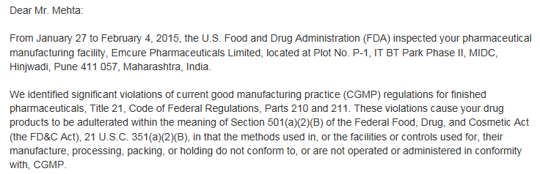
Why are they important?
Data is becoming a popular focus of FDA inspections
Misrepresented data leads to delays in market approval
Inaccurate data undermines FDA efforts to streamline regulatory processes
Emcure Pharmaceuticals (India)- manufactures drugs for Sanofi, Novartis, Roche, Teva and Pfizer
2015 inspection revealed repeated data manipulation and falsification
Environmental monitoring samples were not collected, relied on incomplete data to release products to market
Issued a Warning Letter, FDA bans imports- leads to product recalls (Teva- 40,000+ drugs)

Slide 12
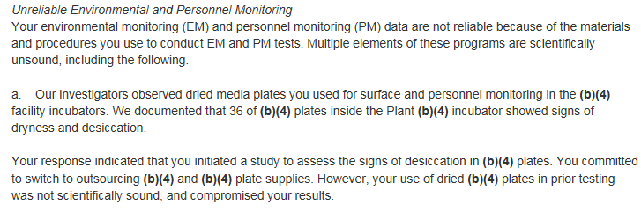
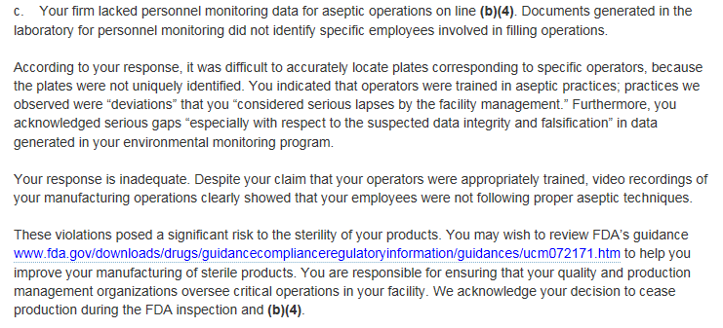

Slide 13
Why are they important?
Penalties- Expensive for companies!
FDA Warning letters
Consent Decree
Approvals revoked
Product seizures
Other injunctions
“Virtually everything in business today is an undifferentiated commodity, except how a company manages its information. How you manage information determines whether you win or lose. How you use information may be the one factor that determines its failure or success — or runaway success.” – Bill Gates

Slide 14
Examples/Strategies for Success
Date and Time Formats:
Acceptable:
07-Nov-2017 (DD-MMM-YYYY)
07 Nov 2017 (DD MMM YYYY)
07 November 2017
November 07, 2017
Unacceptable:
07/11/2017 (May be interpreted as July 11, 2017 in US Format or November 7, 2017 for European format)
07 Nov 17 (4 digit year required)

Slide 15
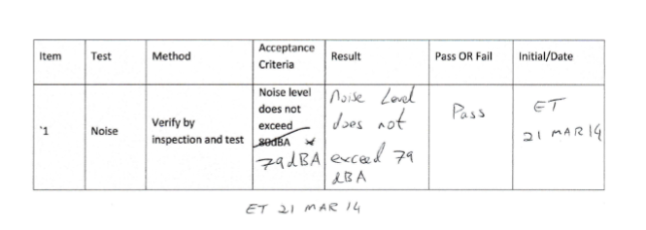
Examples/Strategies for Success
Handwritten entries:
No spaces for handwritten information should be left blank; instead, N/A should be used
“Pass” or “Fail” should be used- NOT “P” or F”
Any changes made to data should have: a one-line strikethrough (which does not obscure initial data), the correction next to or above initial data, AND should be initialed and dated by the executor
A stamp is not an acceptable form of a signature

Slide 16

Examples/Strategies for Success
Reminders:
DO record legibly in permanent ink (black or blue!)
DO sign/date records daily as work progresses
DO initial and date any changes
DO record TRUE information (no fraud!)
DO take your time, stay committed and pay attention to detail

Slide 17

Examples/Strategies for Success
Common Errors:
Missing signatures, initials or dates at time of execution
Obscuring initial data (scribbling/crossing out/white out)
Illegible writing
Incorrect date format
Pre-recording or Back-dating data (don’t do it!)
Leaving fields blank

Slide 18
Examples/Strategies for Success
Remember:
Good Documentation is the PROOF of what you do
The time spent doing the task correctly the first time will prevent, or at least minimize, time-consuming and costly reviews, corrections, and time/money involved in repeating work conducted incorrectly
Poor documentation leads to non-compliance which could have devastating effects on the company, product, YOUR employment and other people’s lives
If it isn’t documented (correctly!), it didn’t happen!

Slide 19

The End!

